Slide 1
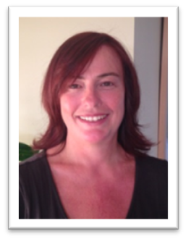
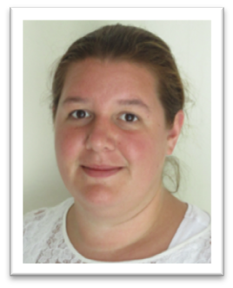
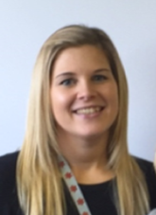

Your School Nurse Team
Ivybridge Medical Practice
School Nurse Team
Station Road
Ivybridge
PL21 0AJ
Tel: 01752 898280
VCL.SHamsPHNT@nhs.net
Catherine Morris, School Nurse
Josie Allis,
Public Health Staff Nurse
Laura Barrett, Community Health Worker

Slide 2
Our School Nurses will provide
Health assessments and support at key transitions
Providing support to children and young people moving into and between schools
Health protection and promotion
Providing information on how you can protect your health and stay well

Slide 3
Our School Nurses will provide
Guidance on managing medical conditions in school
allowing every child to access every area of the curriculum
Emotional Health and Well being
Providing education and support with social and emotional health and wellbeing

Slide 4
From September 2015, we will not be routinely testing children's hearing in Reception. If you have any concerns regarding your child's hearing at any time, please contact the school nurse, class teacher or your GP for further guidance or assessment.

Slide 5
If you have recently moved in from abroad and want to check if your child requires a BCG vaccination, please contact your immunisation team on 01392 356144 for further information.

Slide 6
All children under the age of 16 are eligible for free dental care and vision checks. Children should have their teeth checked six monthly and their eyes tested every two years, or more often if indicated.
If you have health concerns that impact on your child's schooling, please contact your school nurse

